Slide 1
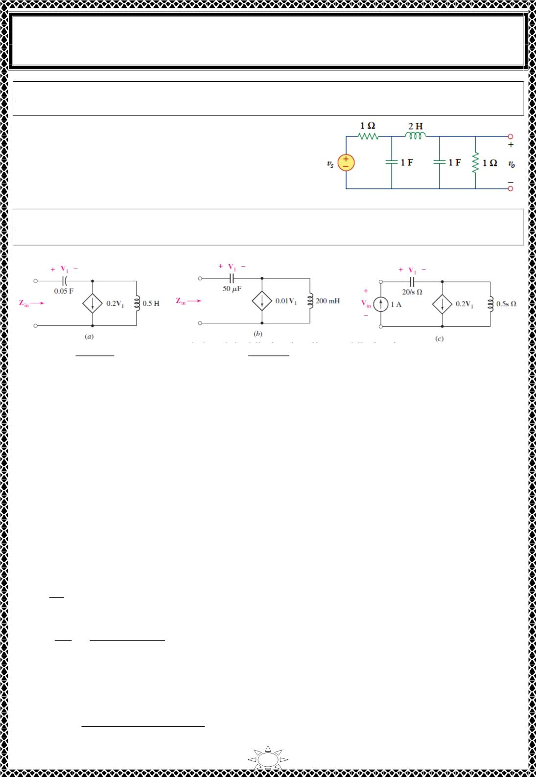
University of Diyala
Engineering College
Electronic Department
Electrical Circuits
2nd Class
Lecturer : Wisam N. AL-Obaidi
Year (2015-2016)
H.W.3: A third-order Butterworth filter normalized to 흎_{풄} = ퟏ rad/s. is shown in Fig.
Scale the circuit to a cutoff frequency of 10 kHz. Use 15-nF capacitors.
′
′
Answer: 푹 = 푹 = ퟏ ∙ ퟎퟔퟏ풌휴,
ퟏ
ퟐ
′
′
푪í = 푪 = ퟏퟓ풏푭, 푳 = ퟑퟑ ∙ ퟕퟕ풎푯.
ퟐ
Example : Scale the network shown in Fig.(a) by 퐾 = 20 and 퐾 = 50, and then find
푍_{푖푛}(푠) for the scaled network.
푚
푓
Solution:
퐶_{ꢀ푐푎푙푒푑}
ꢁ.ꢁꢂ
(ꢃꢁ)(ꢁ.ꢂ)
ꢂꢁ
=
= 50휇퐹 , 퐿_{ꢀ푐푎푙푒푑}
=
= 200ꢄ퐻
Trail Version
Trail Version
Trail Version
Trail Version
Trail Version
Trail Version
Trail Version
Trail Version
Trail Version
Trail Version
Trail Version
Trail Version
Trail Version
(ꢃꢁ)(ꢂꢁ)
In scaling the dependent source, only magnitude scaling need be considered, as frequency
scaling does not affect dependent sources. Since this is a voltage‐controlled current
source, the multiplying constant 0.2 has units 표ꢅ퐴/푉, or S. Since the factor has units of
admittance, we divide by 퐾 , so that the new term is 0.01푉 . The resulting (scaled)
푚
ꢆ
network is shown in Fig.(푏).
To find the impedance of the new network, we need to apply a 1 퐴 test source at the input
terminals. We may work with either circuit; however, let’s proceed by first finding the
impedance of the unscaled network in Fig.(ꢇ), and then scaling the result.
Referring to Fig.(ꢈ)
푉 = 푉 + 0.5푠(1 − 0.2푉 )
푖푛
ꢆ
20
푠
ꢆ
푉_{ꢆ} =
(1)
푉
푠^{ꢃ} − 4푠 + 40
푍 =
푖푛
푖푛
=
1
2푠
To scale this quantity to correspond to the circuit of Fig.(푏) we multiply by 퐾_{푚} = 20, and
replace 푠 with 푠/퐾_{푓} = 푠/50. Thus,
푍_{푖푛}ꢉꢊꢋꢌꢍꢎ
0.2푠^{ꢃ} − 40푠 + 20000
=
푠
훺
18

Slide 2
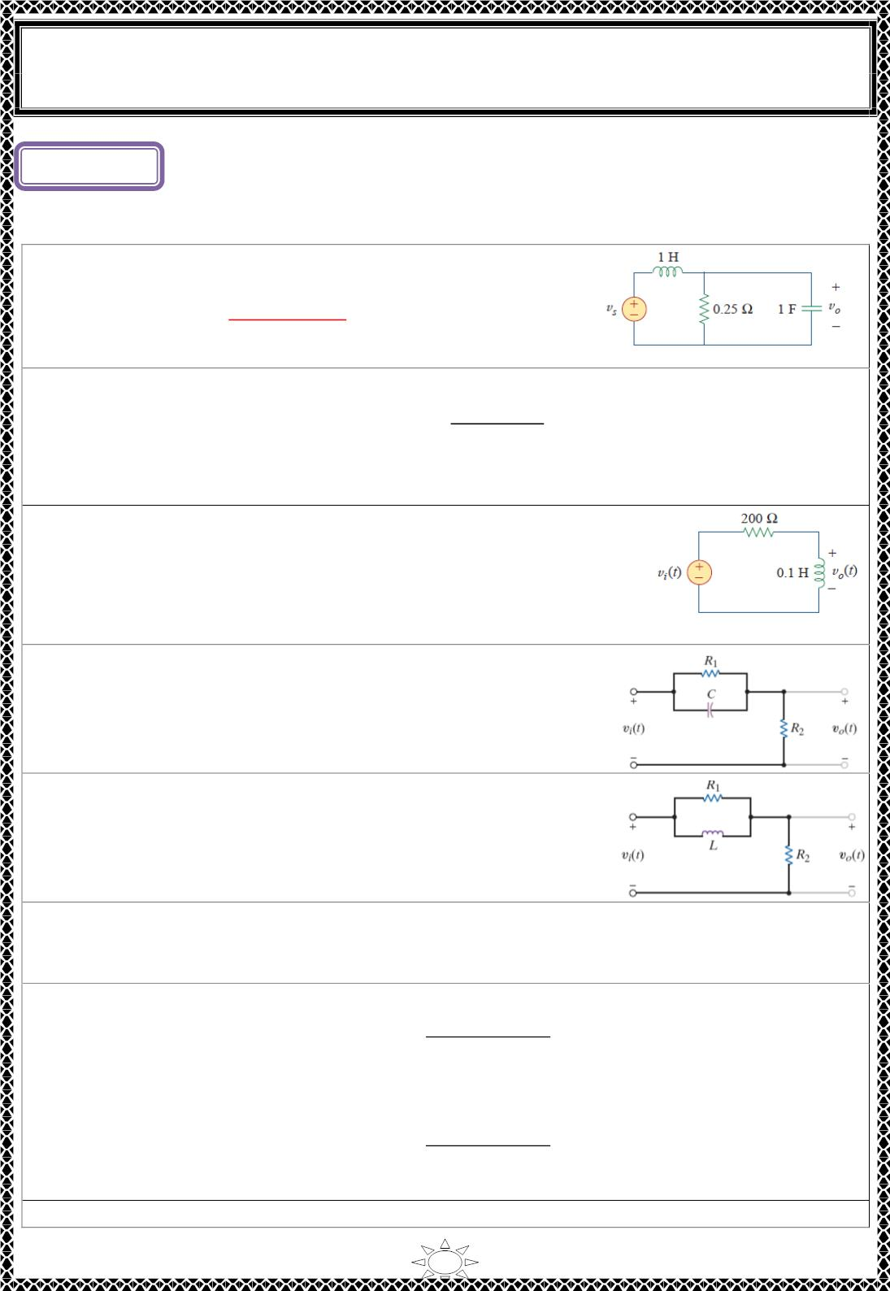
University of Diyala
Engineering College
Electronic Department
Electrical Circuits
2nd Class
Lecturer : Wisam N. AL-Obaidi
Year (2015-2016)
Lecture ()
Passive Filters
Problems
H.W.(1): Find the transfer function V /V of the circuit in
o
s
Fig. Show that the circuit is a lowpass filter.
[Answer: 퐇(흎) =
푹
,H(0) = 1 & H(∞) = 0,
퐑+퐣훚퐋− 훚^{ퟐ}푹푳푪
this circuit is a lowpass filter]
H.W.(2): Determine the cutoff frequency of the lowpass filter described by
퐇(흎) =
ퟒ
ퟐ ꢀ 퐣훚ퟏퟎ
Find the gain in dB and phase of H(ω ) at ω = 2 rad/s.
[Answer: 0.2 Hz, - 14.023, - 84.3°]
H.W.(3): Determine what type of filter is in Fig. Calculate the
corner frequency f_{c} .
Trail Version
Trail Version
Trail Version
Trail Version
Trail Version
Trail Version
Trail Version
Trail Version
Trail Version
Trail Version
Trail Version
Trail Version
Trail Version
[Answer: H(0) = 0 & H(∞) = 1, this circuit is a highpass filter, 318.3 Hz]
H.W.(4): Determine what type of filter the network shown in
Fig. represents by determining the voltage transfer function.
[Answer: the filter is highpass filter]
H.W.(5): Determine what type of filter the network shown in
Fig. represents by determining the voltage transfer function.
[Answer: the filter is lowpass filter]
H.W.(6): Determine the range of frequencies that will be passed by a series RLC bandpass
filter with R = 10 Ω , L = 25mH, and C = 0.4 μ F. Find the quality factor.
[Answer: 1.56 kHz < f < 1.62 kHz, Q = 25]
H.W.(7): (a) Show that for a bandpass filter
풔푩
퐇(풔) =
퐬^{ퟐ} ꢀ 퐬퐁 ꢀ ω²
0
where B = bandwidth of the filter and ω is the center frequency.
0
(b) Similarly, show that for a bandstop filter,
퐬^{ퟐ} ꢀ ω²
퐇(풔) =
0
퐬^{ퟐ} ꢀ 퐬퐁 ꢀ ω²
[Answer]
0
H.W.(8): Determine the center frequency and bandwidth of the bandpass filters in Fig.
1

Slide 3
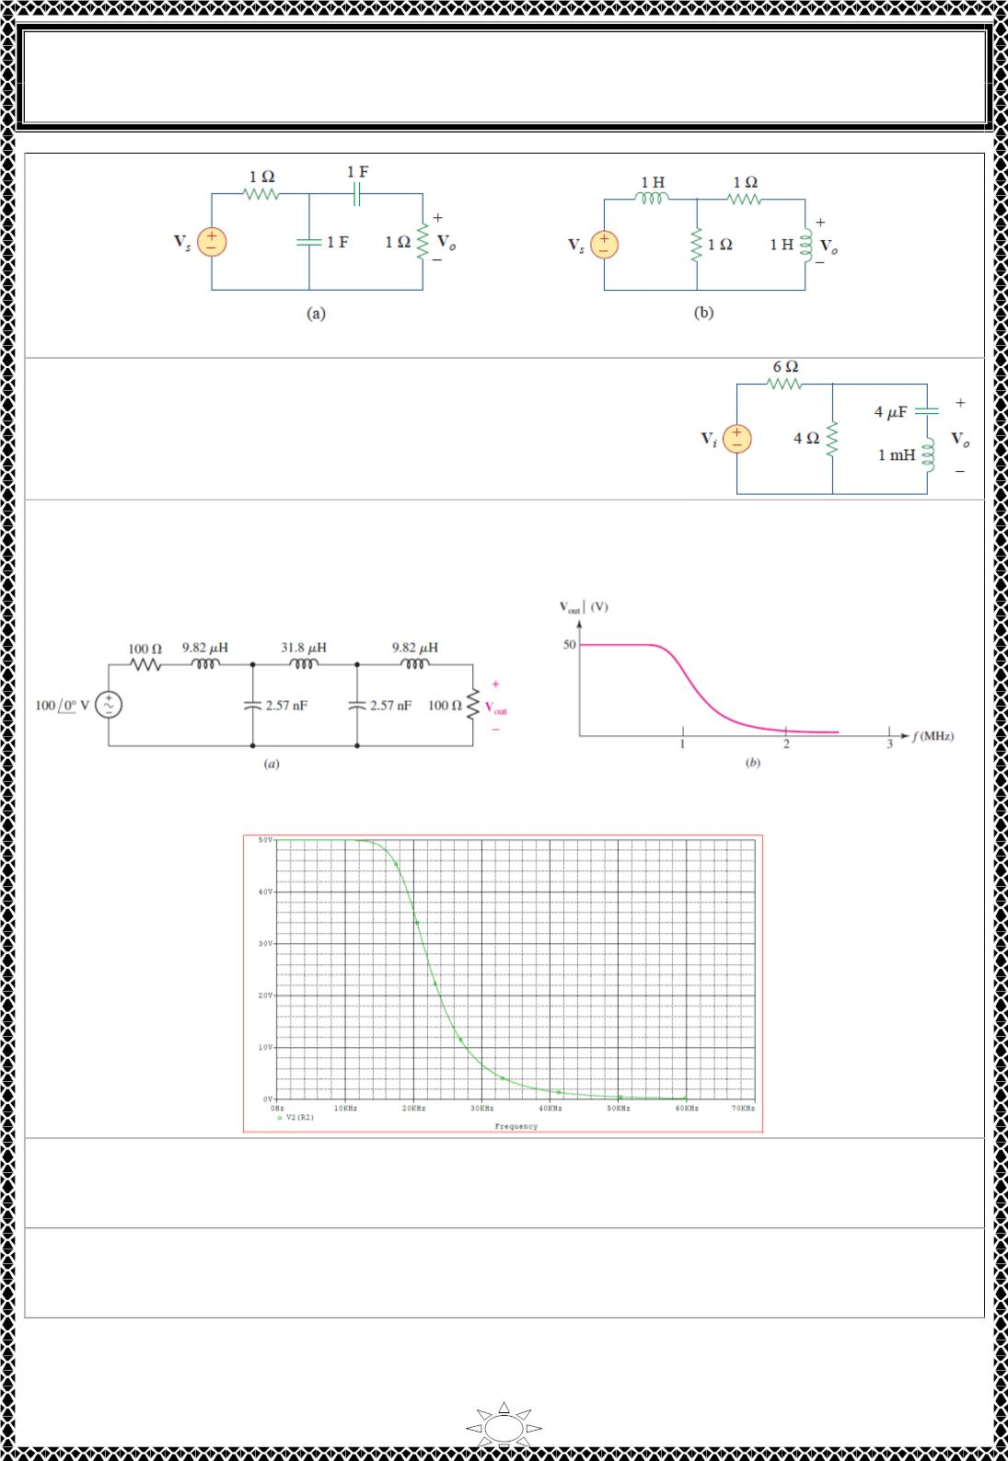
University of Diyala
Engineering College
Electronic Department
Electrical Circuits
2nd Class
Lecturer : Wisam N. AL-Obaidi
Year (2015-2016)
[Answer: (a) ω = 1 rad / s, B = 3 rad / s (b) ω = 1 rad / s, B = 3 rad / s]
0
0
H.W.(9): Find the bandwidth and center frequency of the
bandstop filter of Fig.
[Answer: B = 2.408 krad/ s, 15.811 krad/ s]
H.W.(10): The filter shown in Fig.a has the response curve shown in Fig.b (a) Scale the
filter so that it operates between a 50 Ω source and a 50 Ω load and has a cutoff frequency
of 20 kHz. (b) Draw the new response curve.
Trail Version
Trail Version
Trail Version
Trail Version
Trail Version
Trail Version
Trail Version
Trail Version
Trail Version
Trail Version
Trail Version
Trail Version
Trail Version
[Answer: k = 0.5; k = 20*10^{‐3}, 100 Ω → 50 Ω, 9.82μH → 245.5 μΗ, 31.8 μΗ → 780
m
f
μΗ, 2.57 nF → 257 nF]
H.W.(11): Design a low-pass filter using one resistor and one capacitor that will produce a
4.24-volt output at 159 Hz when 6 volts at 159 Hz are applied at the input.
[Answer: select R = 1 kΩ then C = 1 µF]
H.W.(12): Design a band-pass filter with a low cutoff frequency of approximately 4535
Hz and a high cutoff frequency of approximately 5535 Hz.
[Answer: select C = 100Nf, then L = 10 mH and R = 62.83 Ω]
2

Slide 4
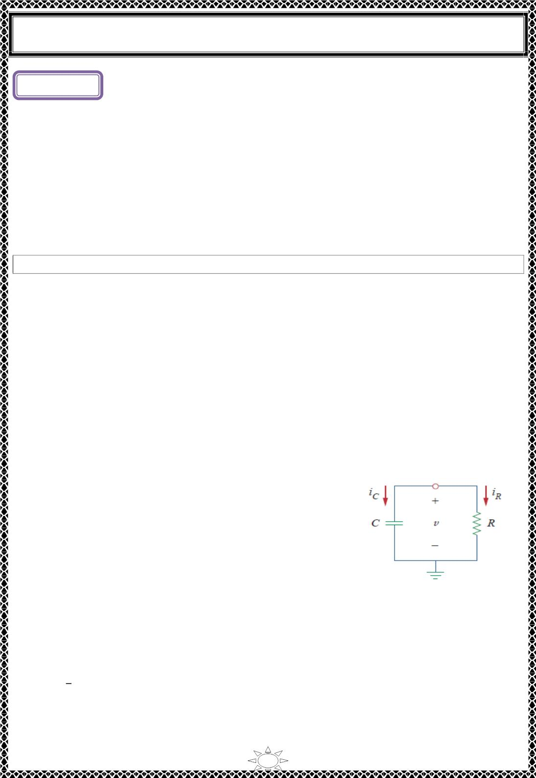
University of Diyala
Engineering College
Electrical Circuits
Lecture ( )
Transient
First-Order Circuits
1) Introduction
The analysis of RC and RL circuits is carried out by applying Kirchhoff’s laws, as we did
for resistive circuits. The only difference is that applying Kirchhoff’s laws to purely
resistive circuits results in algebraic equations, while applying the laws to RC and RL
circuits produces differential equations, which are more difficult to solve than algebraic
equations. The differential equations resulting from analyzing RC and RL circuits are of
the first order. Hence, the circuits are collectively known as first-order circuits.
A first-order circuit is characterized by a first-order differential equation.
In addition to there being two types of first-order circuits (RC and RL), there are two ways
to excite the circuits.
1) The first way is by initial conditions of the storage elements in the circuits. In these
so-called source-free circuits, we assume that energy is initially stored in the capacitive
or inductive element. The energy causes current to flow in the circuit and is
gradually dissipated in the resistors. Although source free circuits are by definition
free of independent sources, they may have dependent sources.
2) The second way of exciting first-order circuits is by independent sources (dc and ac
sources).
Trail Version
Trail Version
Trail Version
Trail Version
Trail Version
Trail Version
Trail Version
Trail Version
Trail Version
Trail Version
Trail Version
Trail Version
Trail Version
2) The Source-Free RC Circuit
A source-free RC circuit occurs when its dc source is suddenly disconnected. The energy
already stored in the capacitor is released to the resistors.
Consider a series combination of a resistor and an initially
charged capacitor, as shown in Fig.2.1. (The resistor and
capacitor may be the equivalent resistance and equivalent
capacitance of combinations of resistors and capacitors.)
Now to determine the circuit response. Since the capacitor is
initially charged, we can assume that at time 푡 = 0, the
initial voltage is
Fig.2.1.source-free RC circuit
푣(0) = 푉
…(2.1)
ꢀ
with the corresponding value of the energy stored as
1
푤(0) = 퐶푉²
…(2.2)
2
ꢀ
Applying KCL at the top node of the circuit in Fig. 2.1 yields
1

Slide 5

University of Diyala
Engineering College
Electrical Circuits
ꢀ + ꢀ = 0
…(2.3)
퐶
푅
By definition, ꢀ = ꢁ푑푣/푑푡 and ꢀ = 푣/ꢂ. Thus,
퐶
푅
ꢃꢄ
ꢃꢅ
ꢄ
ꢁ
∴
+ = 0
…(2.4a)
…(2.4b)
푅
ꢃꢄ
ꢃꢅ
ꢄ
+
= 0
푅퐶
This is a first‐order differential equation, since only the first derivative of 푢 is involved. To
solve it, we rearrange the terms as
ꢃꢄ
ꢄ
1
= − 푑푡
푅퐶
…(2.5)
Integrating both sides, we get
ꢅ
푙푛 푣 = − + 푙푛 퐴
푅퐶
where 푙푛 퐴 is the integration constant. Thus,
Trail Version
Trail Version
Trail Version
Trail Version
Trail Version
Trail Version
Trail Version
Trail Version
Trail Version
Trail Version
Trail Version
Trail Version
Trail Version
ꢄ
ꢅ
푙푛 = −
…(2.6)
…(2.7)
ꢆ
푅퐶
Taking powers of 푒 produces
푣(푡) = 퐴푒^{ꢇꢅ/푅퐶}
But from the initial conditions, 푣(푂) = 퐴 = 푉_{ꢈ}. Hence,
푣(푡) = 푉_{ꢈ}푒^{ꢇꢅ/푅퐶}
This shows that the voltage response of the ꢂꢁ circuit is an exponential decay of the initial
voltage. Since the response is due to the initial energy stored and the physical
characteristics of the circuit and not due to some external voltage or current source, it is
called the natural response of the circuit.
The natural response of a circuit refers to the behavior (in terms of voltages and
currents) of the circuit itself, with no external sources of excitation.
The natural response is illustrated graphically in Fig.2.2. Note that at 푡 = 0, we have the
correct initial condition as in Eq. (2.1). As 푡 increases, the voltage decreases toward zero.
The rapidity with which the voltage decreases is expressed in terms of the time constant,
denoted by 흉, the lowercase Greek letter tau.
2

Slide 6
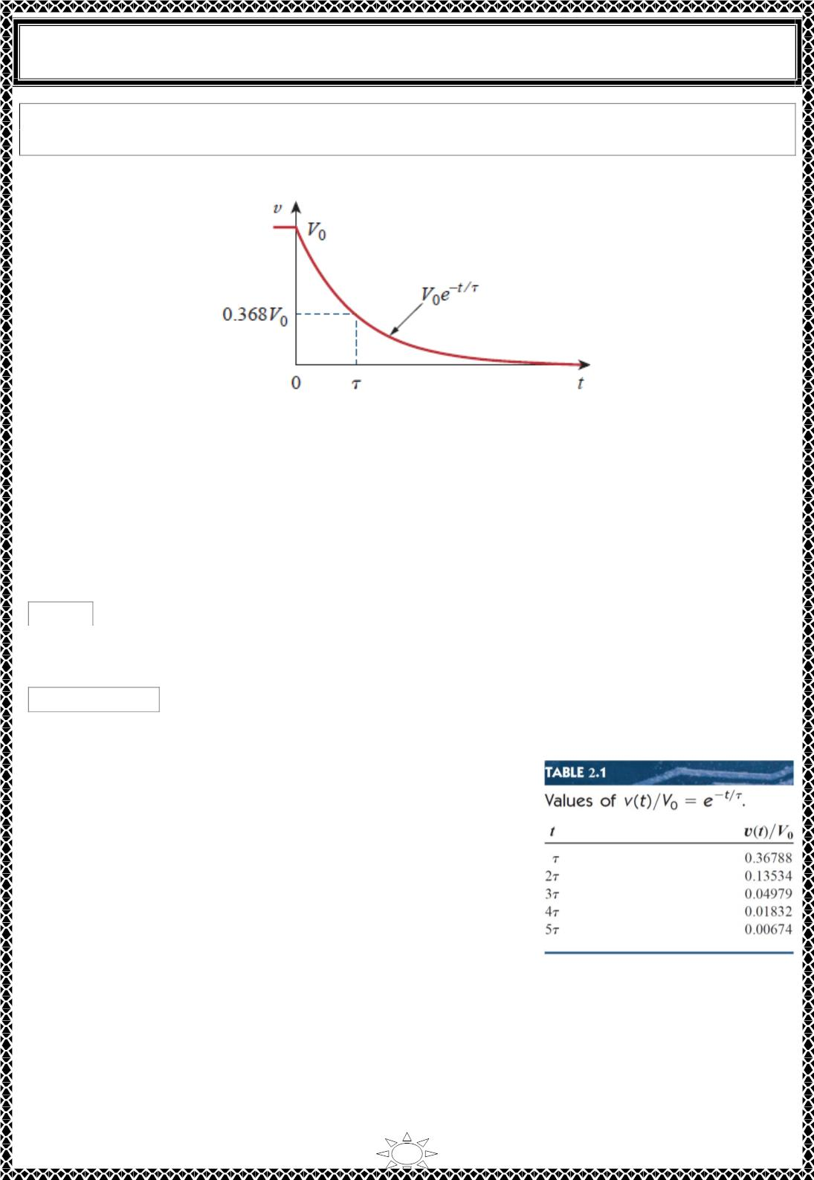
University of Diyala
Engineering College
Electrical Circuits
The time constant of a circuit is the time required for the response to decay to a
factor of 1/e or 36.8 percent of its initial value.
Fig.2.2. The voltage response of the RC circuit.
This implies that at 푡 = 휏, Eq. (2.7) becomes
푉 푒^{−ꢀ/푅퐶} = 푉 푒⁻¹ = ꢁ.368푉
0
0
0
Trail Version
Trail Version
Trail Version
Trail Version
Trail Version
Trail Version
Trail Version
Trail Version
Trail Version
Trail Version
Trail Version
Trail Version
Trail Version
or
휏 = ꢂꢃ
…(2.8)
…(2.9)
In terms of the time constant, Eq. (2.7) can be written as
푣(푡) = 푉₀푒−ꢄ/ꢀ
It is evident from Table 7.1 that the voltage 푣(푡) is less than 1 percent of 푉₀ after ퟓ흉 (five
time constants). Thus, it is customary to assume that the capacitor
is fully discharged (or charged) after five time constants. In other
words, it takes ퟓ흉 for the circuit to reach its final state or
steady state when no changes take place with time. Notice
that for every time interval of 흉, the voltage is reduced by 36.8
percent of its previous value, 풗(풕 + 흉) = 풗(풕)/풆 = ퟎ. ퟑퟔퟖ풗(풕)
, regardless of the value of 풕.
A circuit with a small time constant gives a fast response in that it reaches the steady state (or final
state) quickly due to quick dissipation of energy stored, whereas a circuit with a large time constant
gives a slow response because it takes longer to reach steady state (this is illustrated in Fig. 2.3). At
any rate, whether the time constant is small or large, the circuit reaches steady state in five time
constants.
3

Slide 7
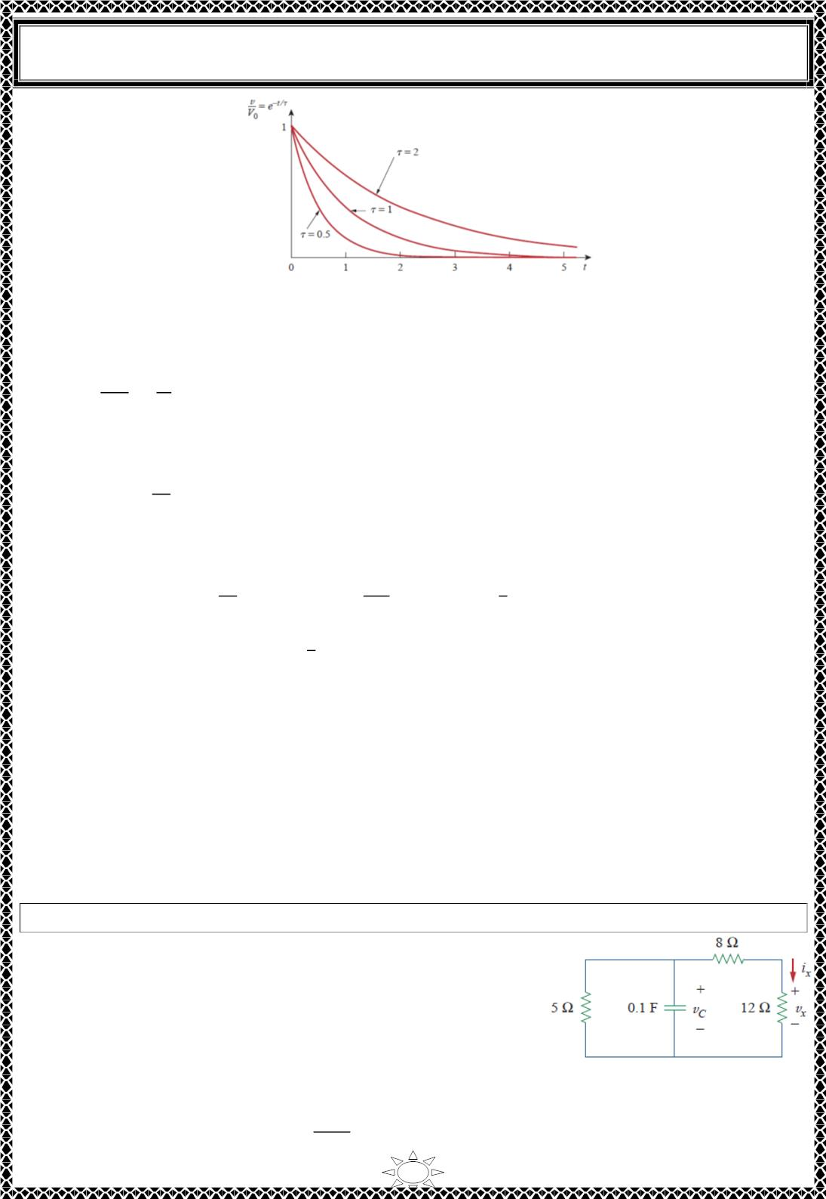
University of Diyala
Engineering College
Electrical Circuits
Figure 2.3. Plot of 푣(푡)/푉₀ = 푒^{−ꢀ/휏} for various values of the time constant.
With the voltage 푣(푡) in Eq. (2.9), we can find the current ꢁ_{푅}(푡) ,
ꢂ(ꢀ)
푅
ꢃ
ꢄ
푅
푒−ꢀ/휏
ꢁ_{푅}(푡) =
=
…(2.10)
…(2.11)
The power dissipated in the resistor is
2
ꢃ
푒−ꢅꢀ/휏
ꢄ
푝(푡) = 푣ꢁ_{푅} =
푅
The energy absorbed by the resistor up to time 푡 is
Trail Version
Trail Version
Trail Version
Trail Version
Trail Version
Trail Version
Trail Version
Trail Version
Trail Version
Trail Version
Trail Version
Trail Version
Trail Version
ꢀ
2
2
ꢀ ꢃ
휏ꢃ
ꢀ
1
ꢅ
ꢄ
푒^{−ꢅꢀ/휏}푑푡 = ꢆ
푒^{−ꢅꢀ/휏}│ = 퐶푉 (ꢇ ꢆ 푒^{−ꢅꢀ/휏}), ꢈ = ꢉ퐶 .(2.12)
푤 (푡) = ∫ 푝 푑푡 = ∫
ꢄ
푅
0
0 푅
ꢅ푅
0 0
ꢅ
1
ꢅ
Notice that as 푡 → ∞, 푤 (∞) → 퐶푉 , which is the same as
푤_{ꢊ}(ꢋ)
, the energy initially
푅
ꢅ
0
stored in the capacitor. The energy that was initially stored in the capacitor is eventually
dissipated in the resistor.
With these two items, we obtain the response as the capacitor voltage 푣_{ꢊ}(푡) = 푣(푡) =
푣(ꢋ)푒^{−ꢀ/휏} other variables (capacitor current ꢁ , resistor voltage 푣 , and resistor current ꢁ )
ꢊ
푅
푅
can be determined. In finding the time constant 흉 = 푹푪, 푹 is often the Thevenin equivalent
resistance at the terminals of the capacitor; that is, we take out the capacitor 푪 and find 푹 = 푹_{푻풉} at
its terminals.
Example 1: In Fig. Fig.1, let 푣 (ꢋ) = ꢇ5 V. Find 푣 , 푣 , and ꢁ for 푡 > ꢋ.
Solution:
ꢊ
ꢊ
푥
푥
We first need to make the circuit in Fig.1 conform with the
standard ꢉ퐶 circuit in Fig.2.1. We find the equivalent
resistance or the Thevenin resistance at the capacitor
terminals. Our objective is always to first obtain capacitor
voltage 푣 . From this, we can determine 푣 and ꢁ .
ꢊ
푥
푥
Fig.1
ꢉ_{ꢌ푞} = (8 + ꢇꢍ) ∥ 5 ⇒ ∴ ꢉ_{ꢌ푞}
ꢅ0×ꢎ
ꢅ0ꢏꢎ
=
= 4훺
4

Slide 8
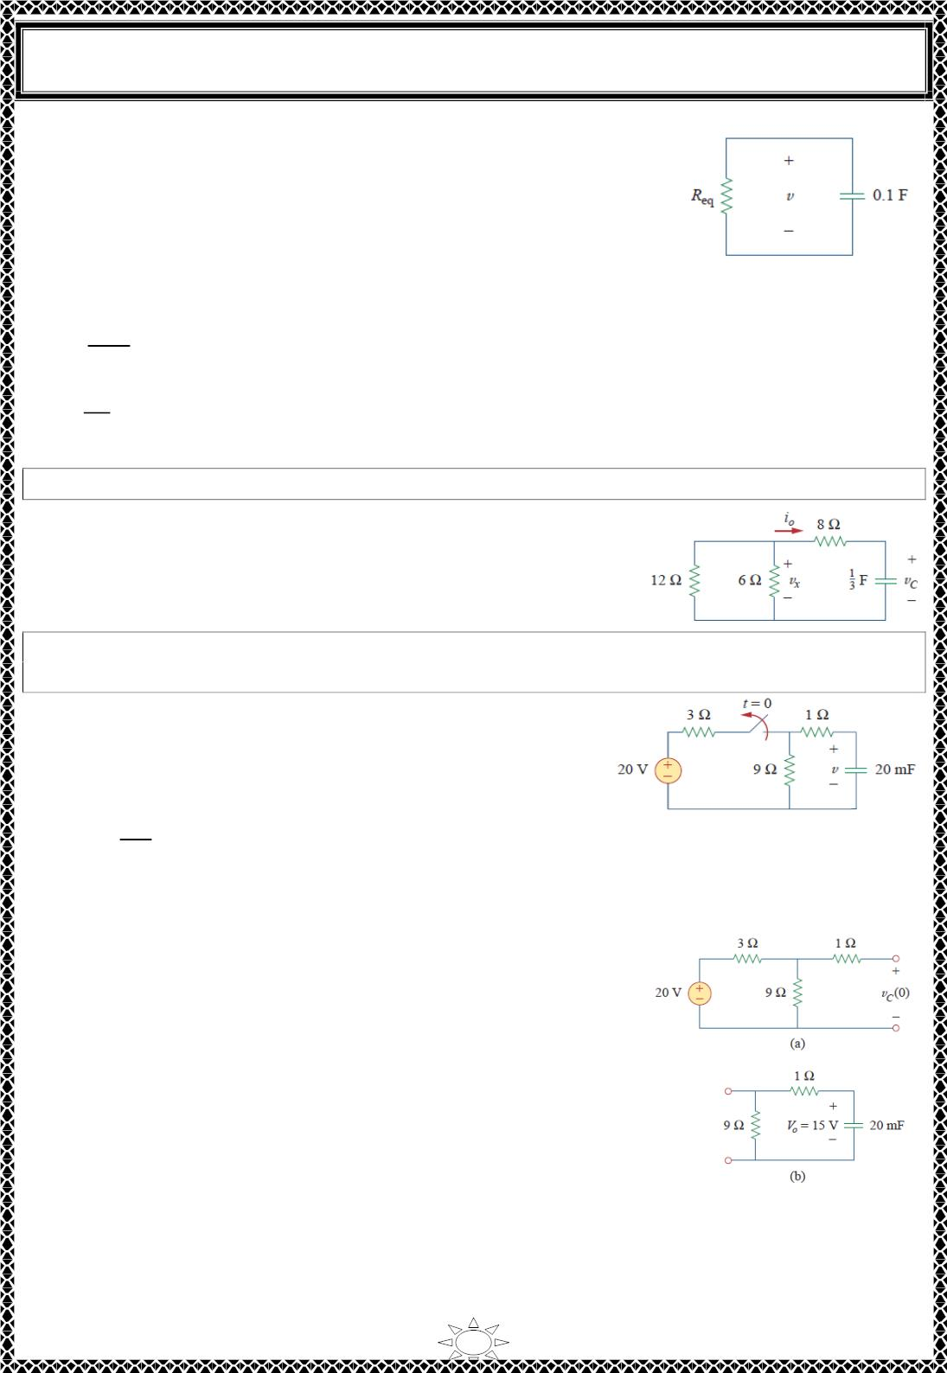
University of Diyala
Engineering College
Electrical Circuits
∴ the equivalent circuit is as shown in Fig.2.
휏 = 푅_{푒푞}퐶 = 4(0.1) = 0.4푠
푣 = 푣(0)ꢀ^{−푡/ꢁ} = 15ꢀ^{−푡/ꢂꢃ}푉. 푣_{ꢄ} = 푣 = 15ꢀ^{−2.ꢅ푡}푉
use voltage division to get 푣_{푥} so,
Fig.2
푣_{푥} =
ꢇ_{푥} =
ꢆ2
푣 = 0.6(15ꢀ^{−2.ꢅ푡}) = 9ꢀ^{−2.ꢅ푡}푉
ꢆ2+8
푣_{푥}
1ꢈ
= 0.75ꢀ^{−2.ꢅ푡}퐴
H.W.1: Let 푣 (0) = 45 V. Determine 푣 , 푣 . and ꢇ for 푓 ≥ 0.
Answer:
ꢄ
ꢄ
푥
표
ퟒퟓ풆^{−ퟎ.ퟐퟓ풕}푽. ퟏퟓ풆^{−ퟎퟐퟓ풕}푽. ꢉퟑ. ퟕퟓ풆^{−ퟎ.ퟐퟓ풕}푨.
Trail Version
Trail Version
Trail Version
Trail Version
Trail Version
Trail Version
Trail Version
Trail Version
Trail Version
Trail Version
Trail Version
Trail Version
Trail Version
Example 2: The switch in the circuit in Fig.1 has been closed fora long time, and it is
opened at ꢊ = 0. Find 푣(ꢊ) for ꢊ ≥ 0. Calculate the initial energy stored in the capacitor.
Solution:
For ꢊ < 0, the switch is closed; the capacitor is an open
circuit to 푑푐 , as represented in Fig.2(a). Using voltage
division
ꢋ
푣_{ꢄ}(ꢊ) =
(ꢈ0) = 15푉. ꢊ < 0
Fig. 1
ꢋ+3
Since the voltage across a capacitor cannot change instantaneously, the voltage across the
capacitor at ꢊ = 0⁻ is the same at
ꢊ = 0, or
푣 (0) = 푉 = 15푉
ꢄ
ꢂ
For ꢊ > 0, the switch is opened, and we have the 푅퐶 circuit
shown in Fig.2 (b). [Notice that the 푅퐶 circuit in Fig.2 (b) is
source free; the independent source in Fig.1 is needed to
provide 푉_{ꢂ} or the initial energy in the capacitor.]
푅 = 1 ꢌ 9 = 10훺 , 휏 = 푅 퐶 = 10 × ꢈ0 × 10⁻³ = 0 ∙ ꢈ푠
푒푞
푒푞
Thus, the voltage across the capacitor for ꢊ ≥ 0 is
Fig.2
푣(ꢊ) = 푣_{ꢄ}(0)ꢀ^{−푡/ꢁ} = 15ꢀ^{−푡/ꢂ∙2}푉 = 15ꢀ^{−ꢅ푡}푉
5

Slide 9
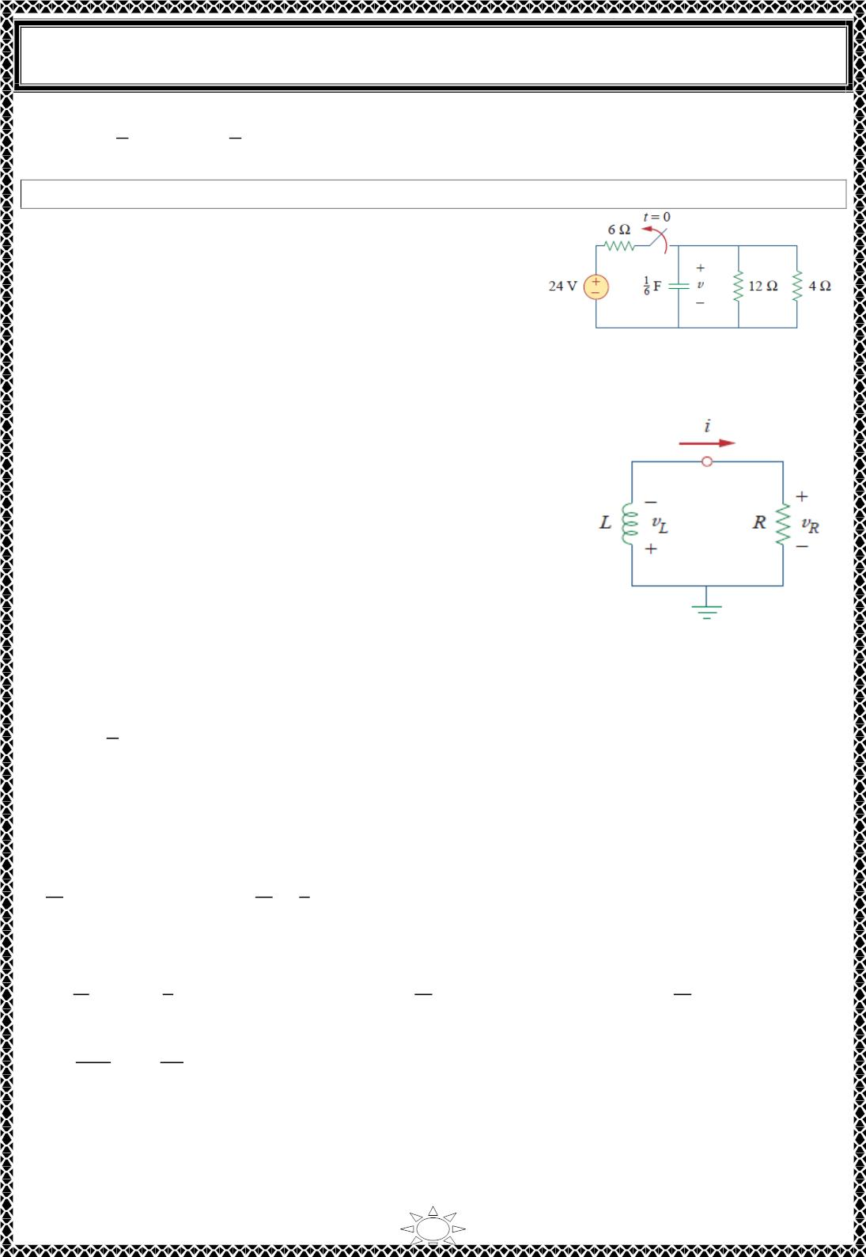
University of Diyala
Engineering College
Electrical Circuits
1
ꢁ
1
푤 (0) = ꢀ푣 (0) = × 20 × 10 × 15ꢁ = 2.25퐽
퐶
2
퐶
2
−3
H.W.2: If the switch in Fig. shown opens at 푡 = 0, find 푣(푡) for 푡 ≥ 0 and 푤 (0) .
Answer: ퟖ풆^{−ퟐ풕푽. ퟓ. ퟑퟑ푱}
퐶
3) The Source‐Free 푹푳 Circuit
Our goal is to determine the circuit response ( current ꢂ(푡)
through the inductor). We select the inductor current as the
response in order to take advantage of the idea ꢂ that the
inductor current cannot change instantaneously. At 푡 = 0,
we assume that the inductor has an initial current 퐼_{ꢃ}, or with
Trail Version
Trail Version
Trail Version
Trail Version
Trail Version
Trail Version
Trail Version
Trail Version
Trail Version
Trail Version
Trail Version
Trail Version
Trail Version
the corresponding energy stored in the inductor as
Fig.3.1 A source-free RL circuit
ꢂ(0) = I_{표}
1
(3.1)
(3.2)
푤(0) = 퐿퐼ꢁ
2
ꢃ
Applying KVL around the loop in Fig.3.1,
푣 + 푣 = 0
(3.3)
ꢄ
푅
But 푣 = 퐿푑ꢂ/푑푡 and 푣 = ꢂꢅ. Thus,
ꢄ
푅
ꢆꢇ
ꢆꢈ
ꢆꢇ
ꢆꢈ
푅
퐿
+ ꢅꢂ = 0
⇒
+ ꢂ = 0
(3.4)
ꢄ
Rearranging terms and integrating gives
ꢇ(ꢈ) ꢆꢇ
ꢈ 푅
ꢃ ꢄ
휄(ꢈ)
푅ꢈ
ꢈ
푅ꢈ
∫
= ꢋ ∫ 푑푡
⇒
ln ꢂ |_{ꢉꢌ} = ꢋ | ⇒ ln ꢂ(푡) ꢋ ln 퐼 = ꢋ + 0
ꢉ
ꢇ
ꢄ
ꢃ
ꢃ
ꢄ
ꢊ
∴ ln
ꢂ(푡)
ꢅ푡
퐿
퐼
= ꢋ
(3.5)
(3.6)
ꢃ
Taking the powers of 푒, we have
ꢂ(푡) = 퐼_{ꢃ}푒−푅ꢈ/ꢄ
6

Slide 10
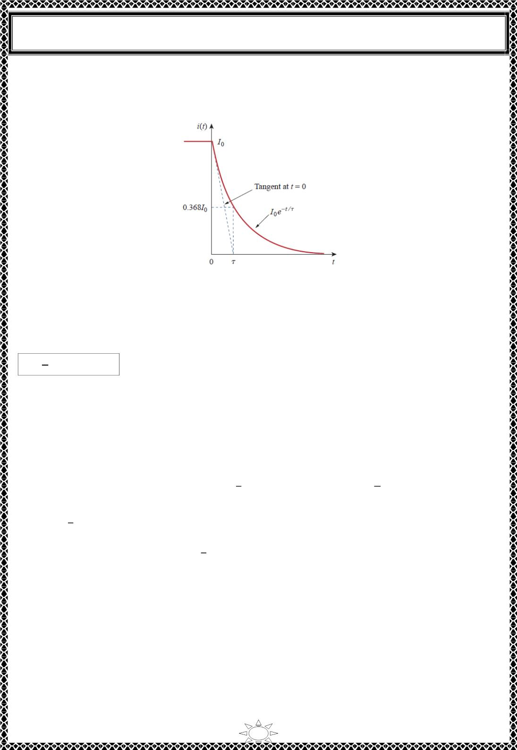
University of Diyala
Engineering College
Electrical Circuits
This shows that the natural response of the 푅퐿 circuit is an exponential decay of the initial
current. The current response is shown in Fig.3.2.
Fig.3.2. The current response of the RL circuit
It is evident from Eq. (3.6) that the time constant for the 푅퐿 circuit is
Trail Version
Trail Version
Trail Version
Trail Version
Trail Version
Trail Version
Trail Version
Trail Version
Trail Version
Trail Version
Trail Version
Trail Version
Trail Version
ꢀ
휏 =
in (s)
(3.7)
ꢁ
∴ ꢂ(푡) = 퐼₀푒−ꢃ/ꢄ
(3.8)
(3.9)
푣 (푡) = ꢂ푅 = 퐼 푅푒−ꢃ/ꢄ
ꢁ
0
The power dissipated in the resistor is
(3.10)
푝 = 푣 ꢂ = 퐼²푅푒−2ꢃ/ꢄ
ꢁ
0
ꢃ
ꢃ
ꢃ
1
ꢀ
푤 (푡) = ∫ 푝 푑푡 = ∫ 퐼² 푅푒^{−2ꢃ/ꢄ}푑푡 = ꢅ 휏퐼²푅푒^{−2ꢃ/ꢄ}| ,
휏 =
ꢁ
0
0
0
2
0
0
ꢁ
1
푤 (푡) = 퐿퐼²(ꢆ ꢅ 푒^{−2ꢃ/ꢄ})
(3.11)
ꢁ
2
0
1
2
Note that as 푡 → ∞ ,푤 (∞) → 퐿퐼 , which is the same as
푤ꢀ(ꢇ)
, the initial energy
ꢁ
2
0
stored in the inductor as in Eq. (3.2). Again, energy initially stored in the inductor is
eventually dissipated in the resistor.
With the two items, we obtain the response as the inductor current ꢂꢀ(푡) = ꢂ(푡) =
ꢂ(ꢇ)푒^{−ꢃ/ꢄ}. Once we determine the inductor current ꢂ , other variables (inductor voltage 푣 ,
ꢀ
ꢀ
resistor voltage 푣 , and resistor current ꢂ ) can be obtained. Note that in general, 푹 in Eq.
ꢁ
ꢁ
(3.7) is the Thevenin resistance at the terminals of the inductor.
7

